Slide 1

Housing PRICE PREDICTION
Presented By
Aamina Ruvaida

Slide 2
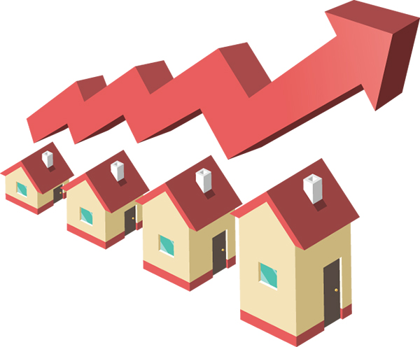
As the size of house increases. So, the price of house also increases.

Slide 3
Content
Over View
Problem Statement
Problem Understanding
Exploratory Data Analysis
Visualization
Steps and Assumption
Model Building
Variation Inflation Factor
Cross Validation Score
Hyper Parameter Tuning
Conclusion

Slide 4
Overview: In the Housing Price Prediction project we will look into * How to Analysis the data of housing prediction datasets? * How to describe data through Visualization? * How to convert Categorical data to Numerical Data? * How to check the Correlation of data? * What are the steps of Exploratory Data Analysis? * Cleaning of Data * Model Building * Hyper parameter tuning * Predicting the House Price for Test Dataset.

Slide 5
Problem Statement
A US-based housing company named Surprise Housing has decided to enter the Australian market. The company uses data analytics to purchase houses at a price below their actual values and flip them at a higher price. For the same purpose, the company has collected a data set from the sale of houses in Australia. The data is provided in the CSV file below.
The company is looking at prospective properties to buy houses to enter the market. You are required to build a model using Machine Learning in order to predict the actual value of the prospective properties and decide whether to invest in them or not. For this company wants to know:
• Which variables are important to predict the price of variable?
• How do these variables describe the price of the house?

Slide 6
Problem Understanding
House price prediction help the developer to predict the price in the real estate to buy the house at the right time to the affordable price. The price of house is drastically increasing day by day.
The house of price depends on various features based on locality, size of house, year of house since build, material used in building the house. Facilities like parking, play ground, gym, airport, bus stand, railways station. In this type of area the price of house will be high.
As a data scientist, we have to predicted the price of house by analysis the various features

Slide 7
Importance of House Price Prediction
House price prediction is very important in predicting the price of house in the real estate.
In the Earlier days we buy the house by the size and locality.
Nowadays we buy house only when we have more information like what are the facilities have near the house. Lots of question raise when we tends to buy a house. Is the school near to house? Is there Parking facilities? Is there play ground available for kids? Grocery store and necessary usage items available near to house etc. All this things matter when we buy the house.
Based on this information, we predict the price of house. If there is no facilities that area price of house will be less as compare to that area where all the facilities are provided.
To predict price of house, we gather lot’s of information and analyses it to give a better prediction in the real estate.

Slide 8

Exploratory Data Analysis
As we begin to explore data, first we have imported the data and necessary libraries, checked the count of data. In train data there are 1168 Rows and 81 columns. In test data we have 292 rows and 80 columns.
We checked the column name, unique data, info of data. Checked the statistical summary of data.
In ID column the count is 1168 that means there is null no null value present in ID Column. We check the null values and in most of the columns the null value is present. We then did the imputation to replace the null values with mean if it is numerical data and replace with mode if it is categorical data.
In Feature engineering, we have separated the year column into day, month and year. Then dropped the year column. We have dropped the unnecessary column present in data

Slide 9
We checked the data type, there are integer, float and object data type present.
We have separate the data into categorical and numerical data. We than visualize the features using bar plot, boxplot, heatmap.
Checked the skewness present in data. We removed the skewness using pre-processing technique Power Transformer.
We converted the categorical data to numerical data using the Label Encoder.
We scaled the data and checked the variance inflation factor. There is VIF present in data, we dropped the GrLivArea column as It contain high inflation factor.
We have cleaned the data and processed. Now it is ready to go for training and testing.
We use various machine learning models to test the data and make a good predictions.

Slide 10
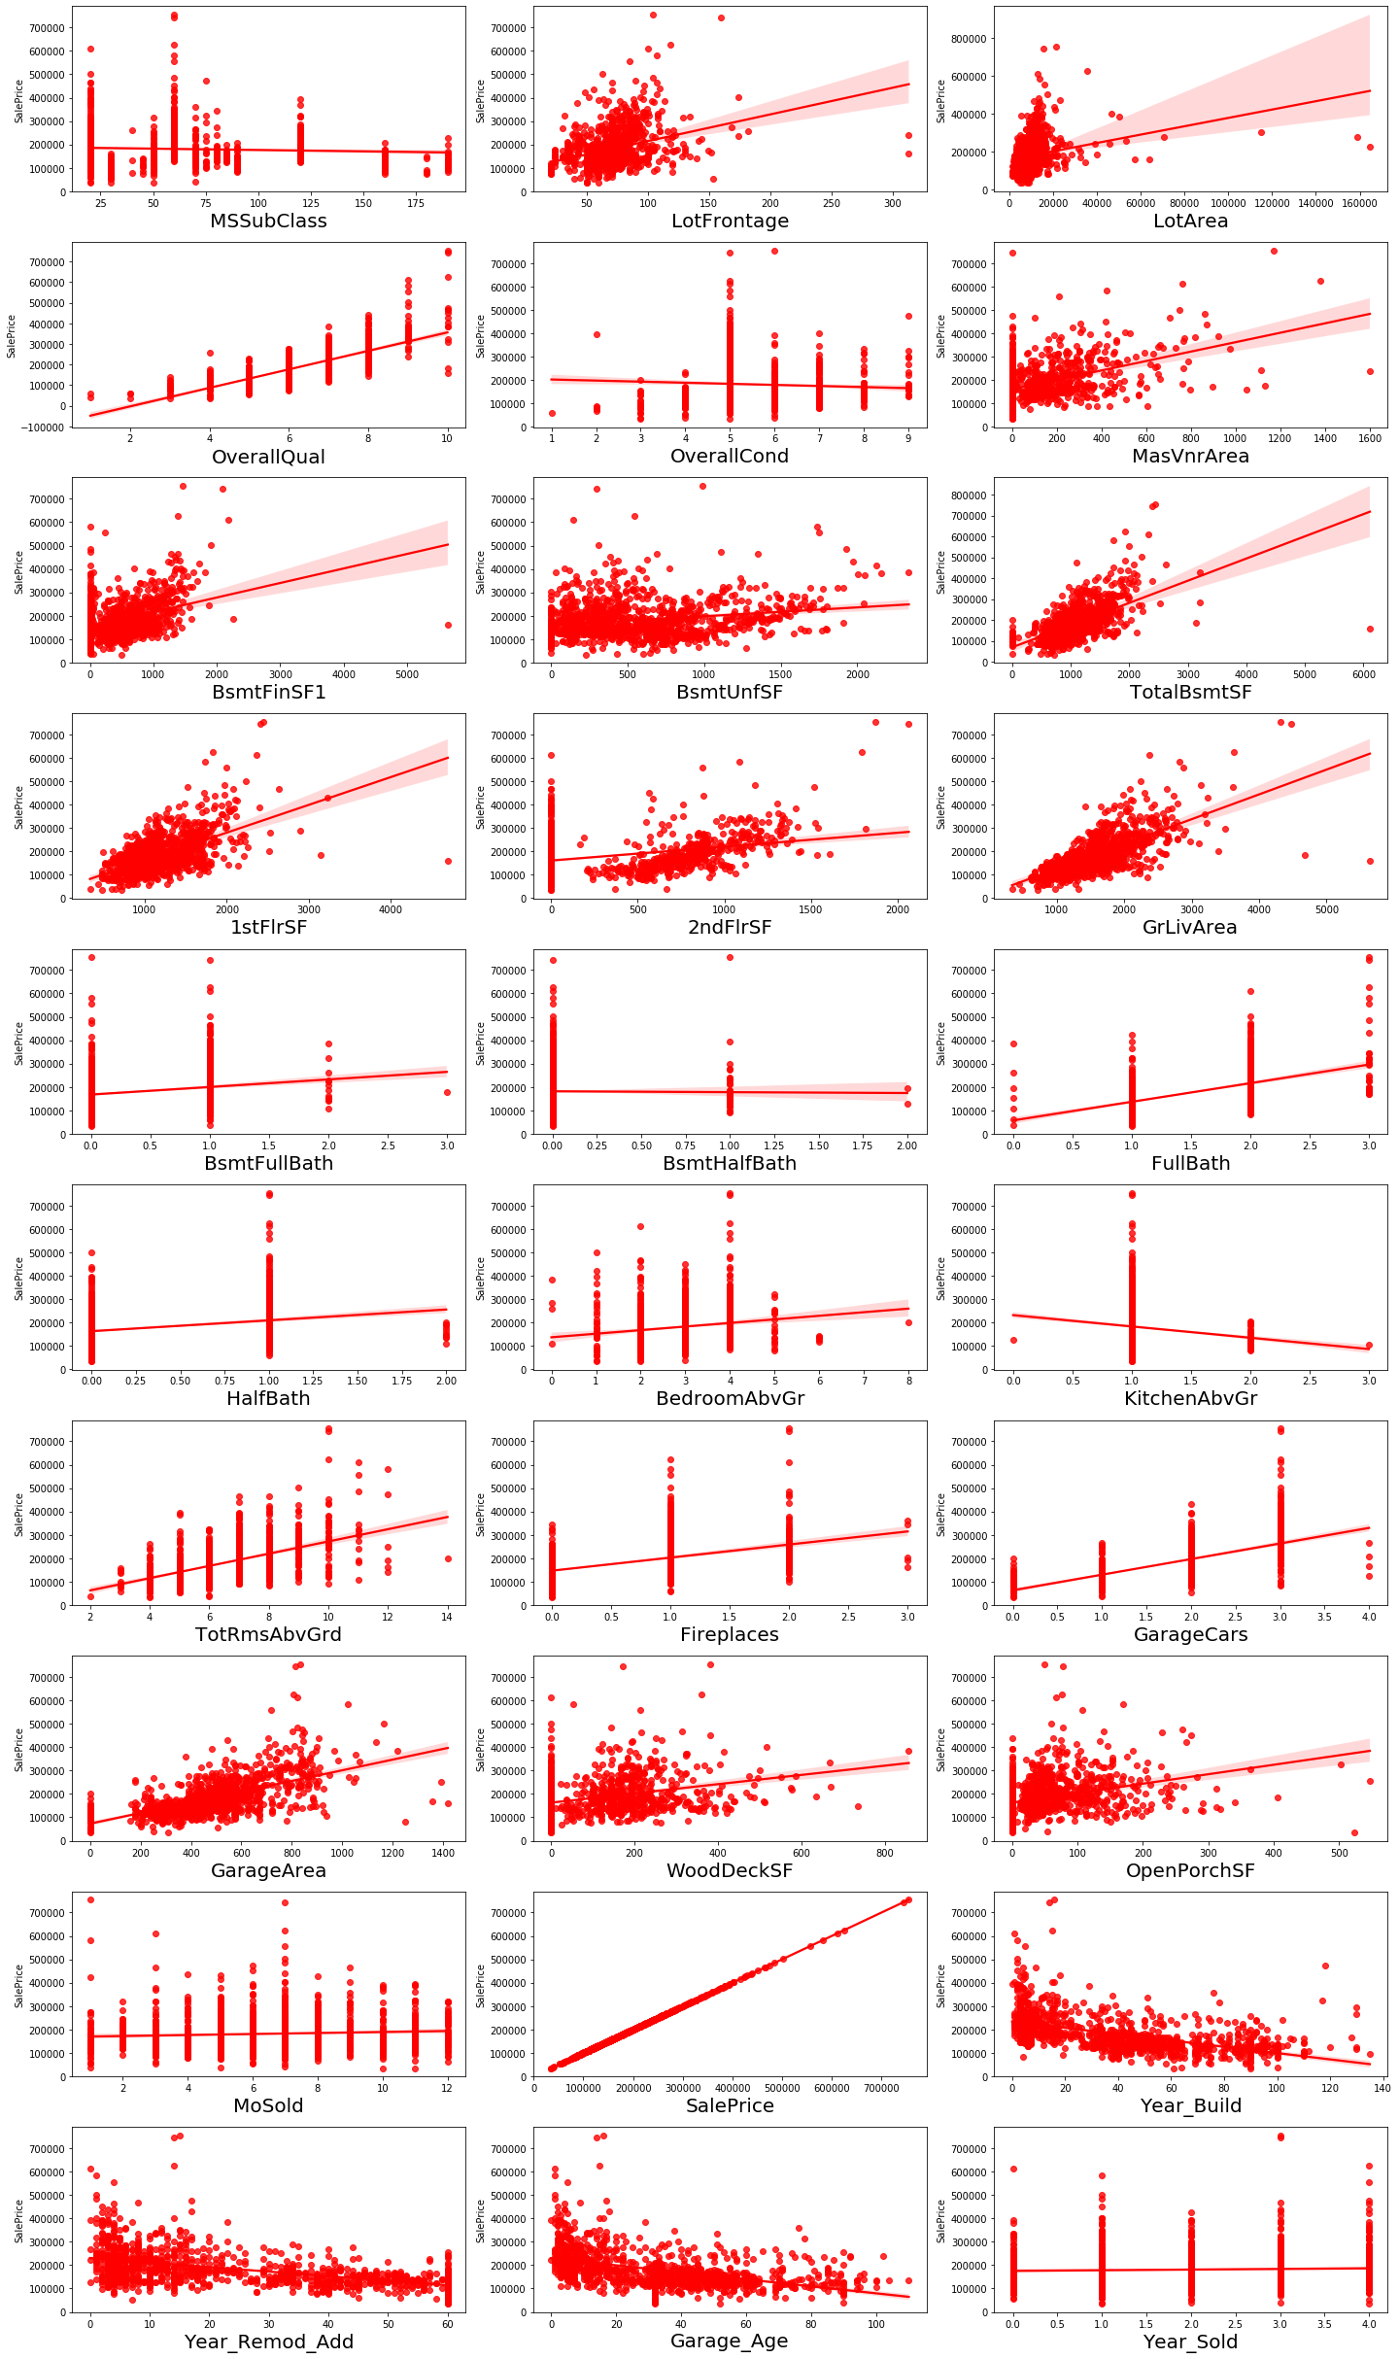
Visualization of Regression plot

Slide 11
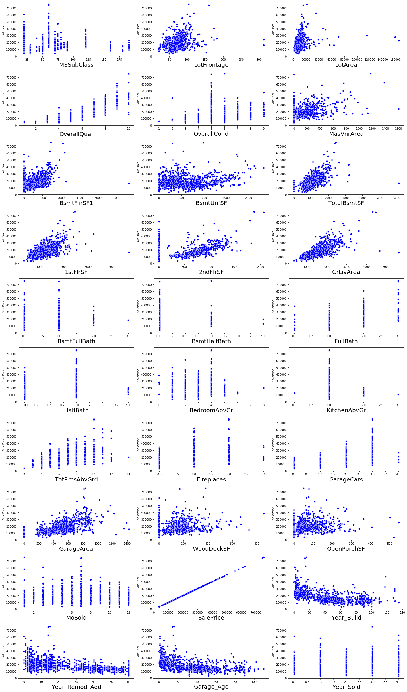
Visualization of Scatterplot for Numerical Data

Slide 12
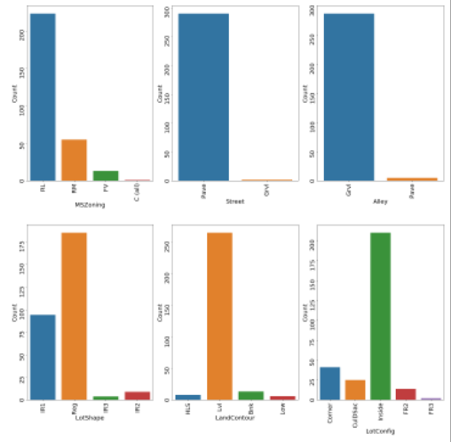
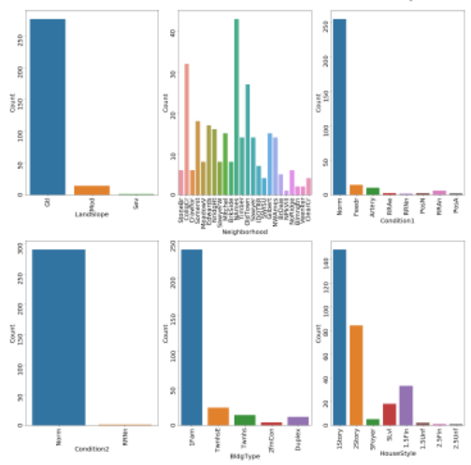
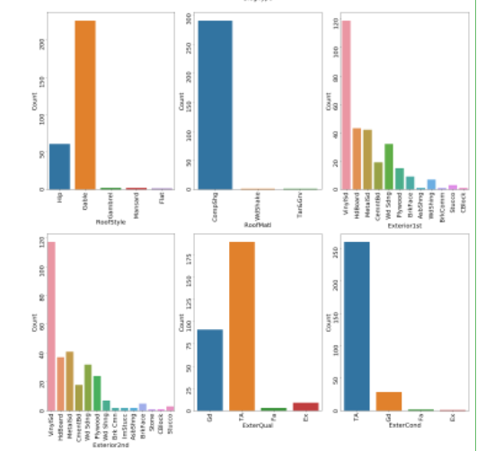
Visualization of Categorical data in Test data

Slide 13
Observation
Residential Low Density count is high as compare to other MSZoning
* In the Stree Pave count is high, in increase of sales it also depends on the type of street
* In the general shape of the property, the regural shape has the maximum count, Single Regular count is also little high next to regular shape.
* If we see the flatness of the property, the property which is having the Near Flat level has maximum count. In the Depression flatness of propery has very less count.
* In the lot configuration, inside lot configuration has the maximum count.
* In the slope of propety, the gentle slope has the maximum count.
* In the Neighborhood: Physical locations within Ames city limits, NAMES has the maximum count as compare to others.
* In Condition1, proximity to various condition the normal condition has the maximum count. Many people to have normal proximity condition. So, its count is high.
* In Condition2, Proximity to various conditions (if more than one is present) also people prefer the normal condition. So, it has the maximum count.
* In BldgType, the type of dwelling, 1 Farm-Single Family Detached has the maximum count.
For Vinyl Siding exterior-2 covering on house has maximum counts for the feature Exterior covering on house (if more than one material)(Exterior2nd).
* For Masonry veneer type(MasVnrType) None has maximum count.

Slide 14
For Typical/Average(TA) quality of the material on the exterior has maximum count, for the feature Evaluates the quality of the material on the exterior (ExterQual).
* For Typical/Average(TA) condition of the material on the exterior has maximum count for the feature Evaluates the present condition of the material on the exterior(ExterCond).
* For Cinder Block and Poured Contrete foundations the count is maximum for the feature Type of foundation(Foundation).
* For good and average quality heights of the basement the count is high for the feature Evaluates the height of the basement(BsmtQual).
* For Typical/Average(TA) general condition of the basement the count is high for the feature Evaluates the general condition of the basement(BsmtCond)
* For No Exposure garden level walls the count is maximum for the feature Refers to walkout or garden level walls(BsmtExposure).
* For unfinished Rating of basement finished area-1 the count is maximum for the feature Rating of basement finished area(BsmtFinType1).
* For unfinished Rating of basement finished area-2 the count is maximum for the feature Rating of basement finished area (if multiple types)(BsmtFinType2).
* For Gas forced warm air furnace type of heating the count is maximum for the feature Type of heating(Heating).
* For Excellent Heating quality and condition the count is high for the feature Heating quality and condition(HeatingQC).
* For Central air conditioning-yes has maximum count for the feature Central air conditioning(CentralAir).
* For Standard Circuit Breakers & Romex Electrical system the count is high for the feature Electrical system(Electrical).
* For Typical/Average(TA) and good Kitchen quality the count is maximum for the feature Kitchen quality(KitchenQual).
* Typical Functionality has highest count for Home functionality (Assume typical unless deductions are warranted)(Functional).
* For good Fireplace quality the count is high for the feature Fireplace quality(FireplaceQu).
* If Garage location Attached to home then the count is high, for the feature Garage location(GarageType).
* For Unfinished Interior of the garage the count is maximum, for the feature Interior finish of the garage(GarageFinish).
* For Typical/Average(TA) Garage quality the count is high, for the feature Garage quality(GarageQual).
* For Typical/Average(TA) Garage condition the count is high, for the feature Garage condition(GarageCond).
* For Paved driveway the count is maximum, for the feature Paved driveway(PavedDrive).
* For Warranty Deed - Conventional type of sales the count is maximum, for the feature Type of sale(SaleType).
* For Normal sales condition the count is high, for the feature Condition of sale(SaleCondition).

Slide 15
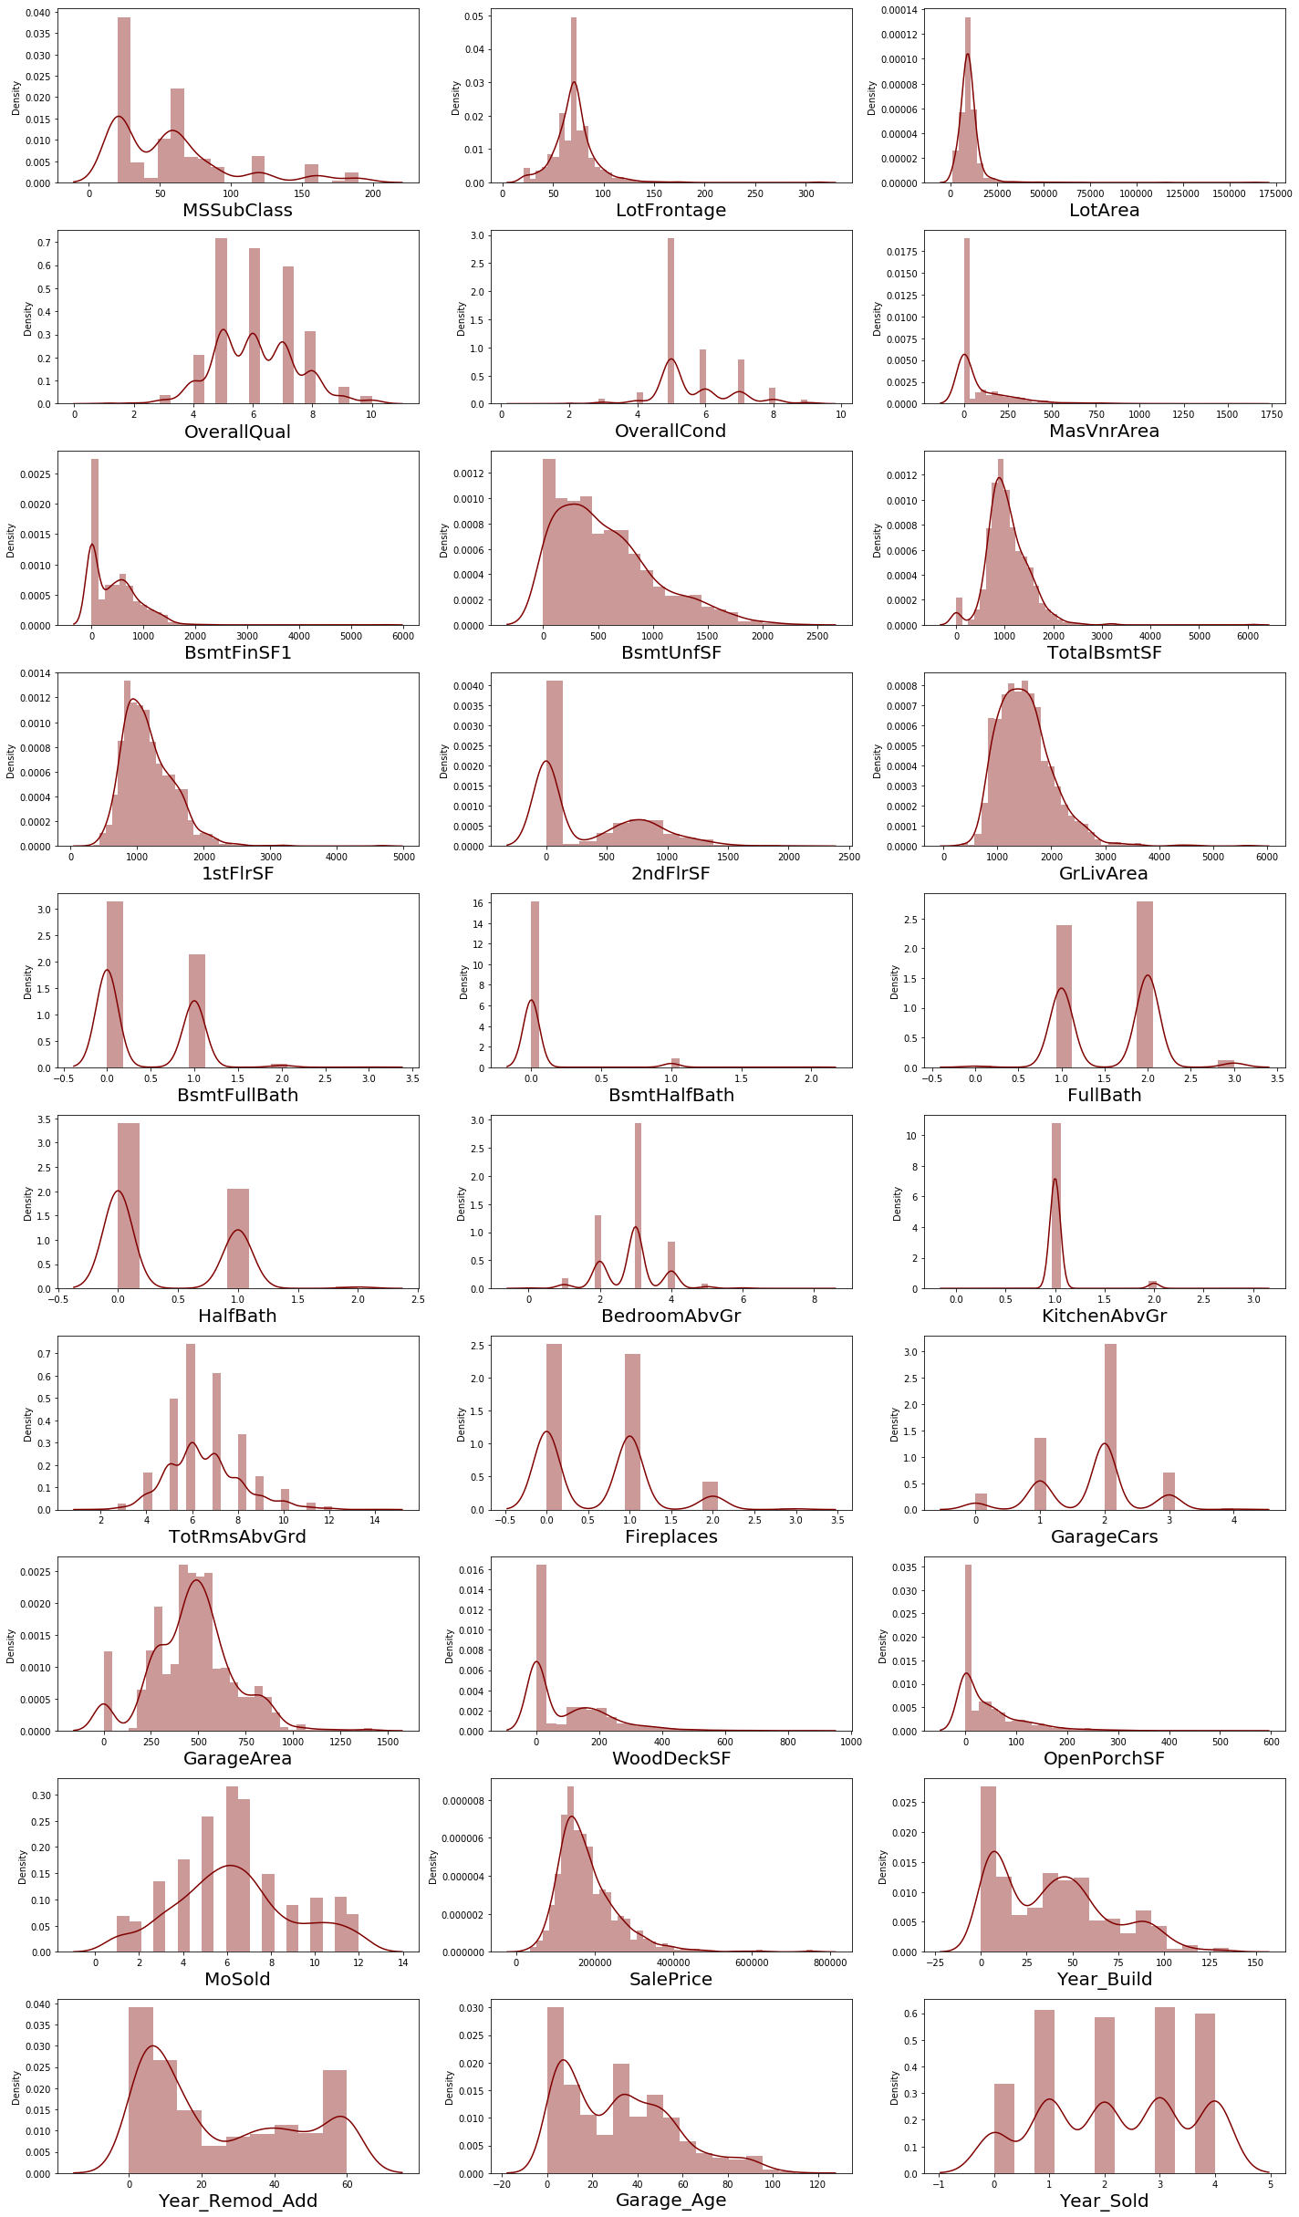
Distribution plot of Numerical data for Train Data

Slide 16
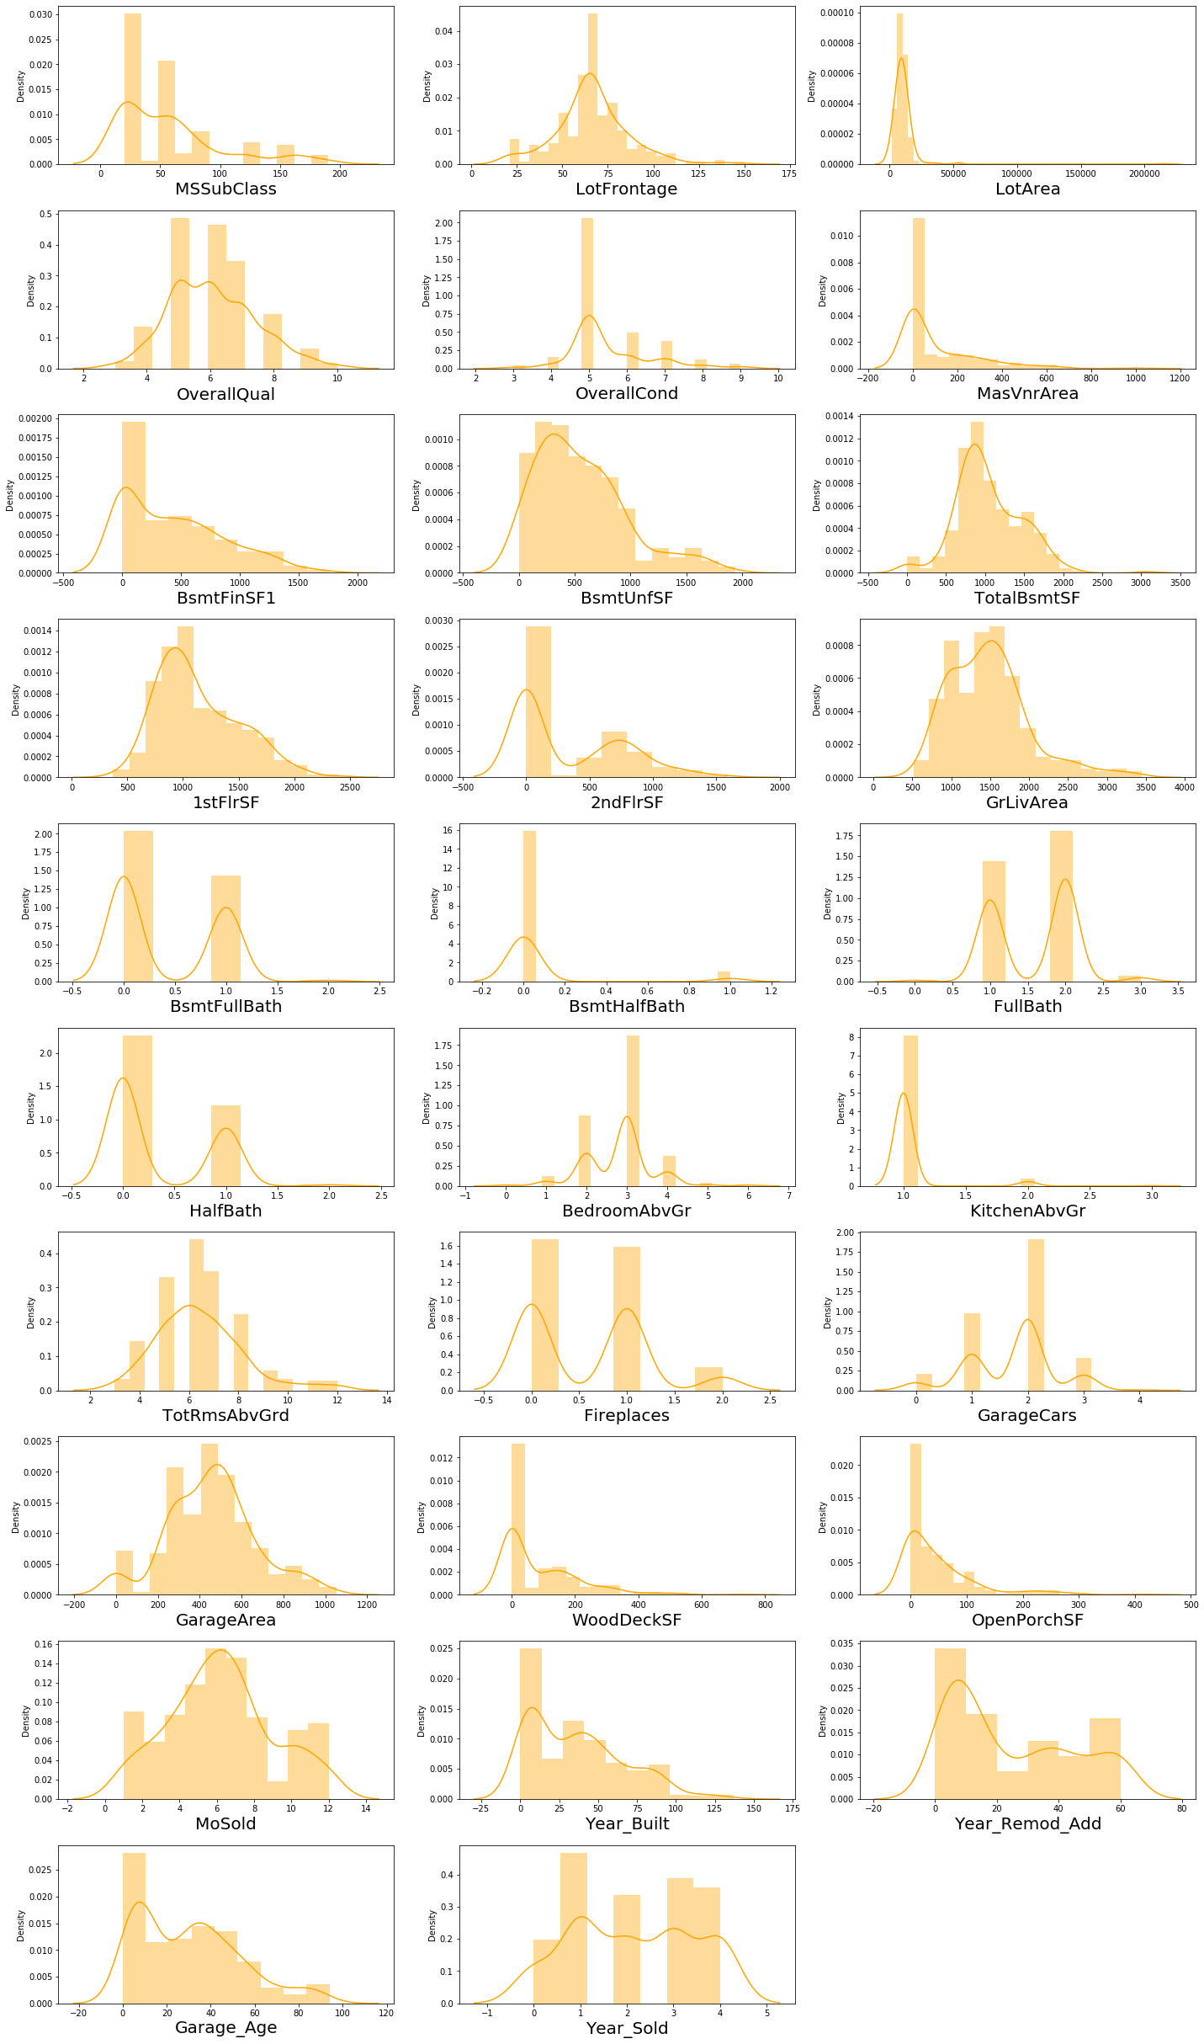
Distribution plot for Test Data

Slide 17
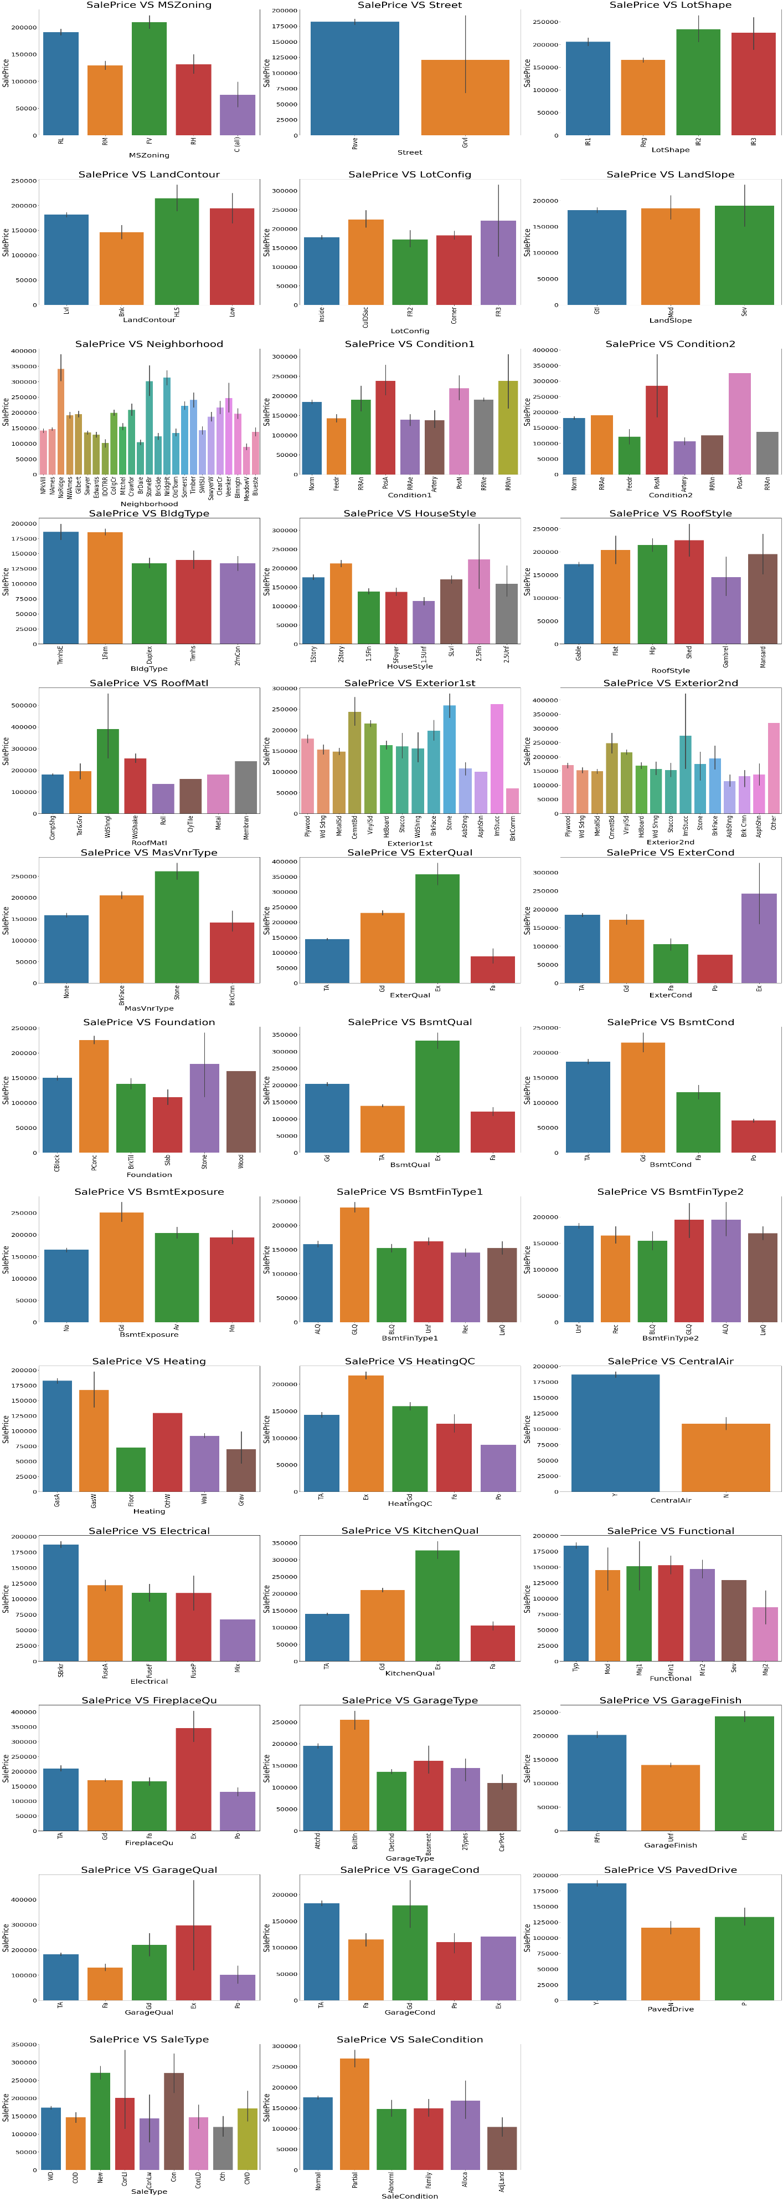
Visualization of Categorical data with Sales Price
For Home just constructed and sold (New) and Contract 15% Down payment regular terms (Con) of type of sale (SaleType) as highest SalePrice.
For Home was not completed when last assessed (associated with New Homes) (Partial) Condition of sale (SalesCondition) the SalePrice is maximum.

Slide 18
INSIGHT:
I have used the barplot, scatterplot, regression plot , distribution plot for visualization of data.
It show that relationship with each feature with respect to Sale Price.
In numerical data we used the regression plot that show the relationship of each features with the target variables.
There is a linear relationship between the continuous and target variable.
We checked the correlation of data, in some feature that are high correlated.

Slide 19
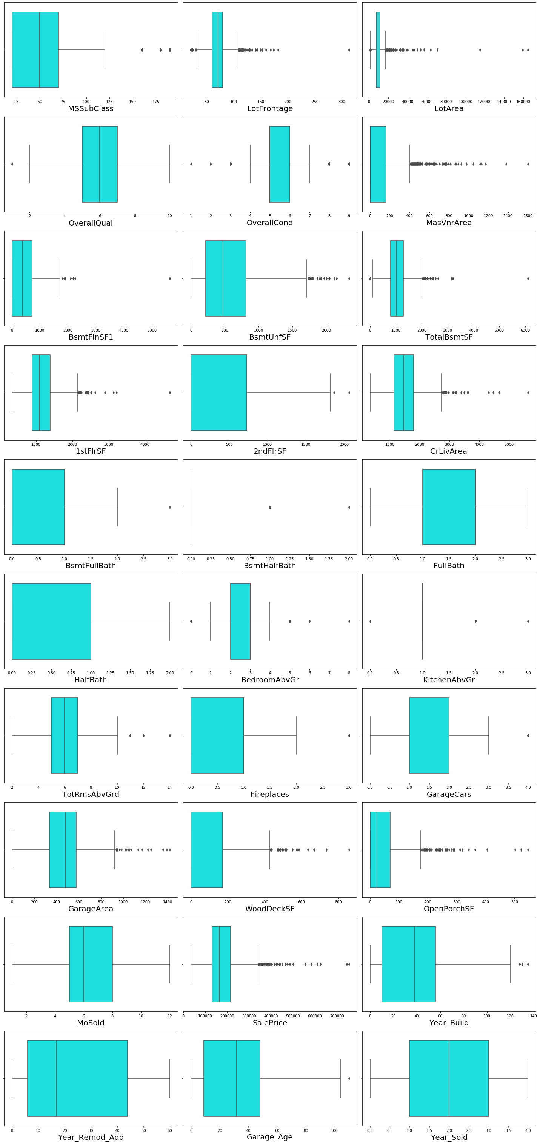
Outliers in train data

Slide 20
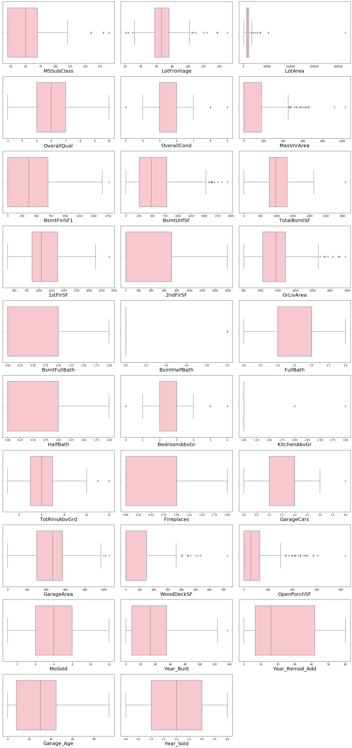
Outliers in TEST DATA

Slide 21
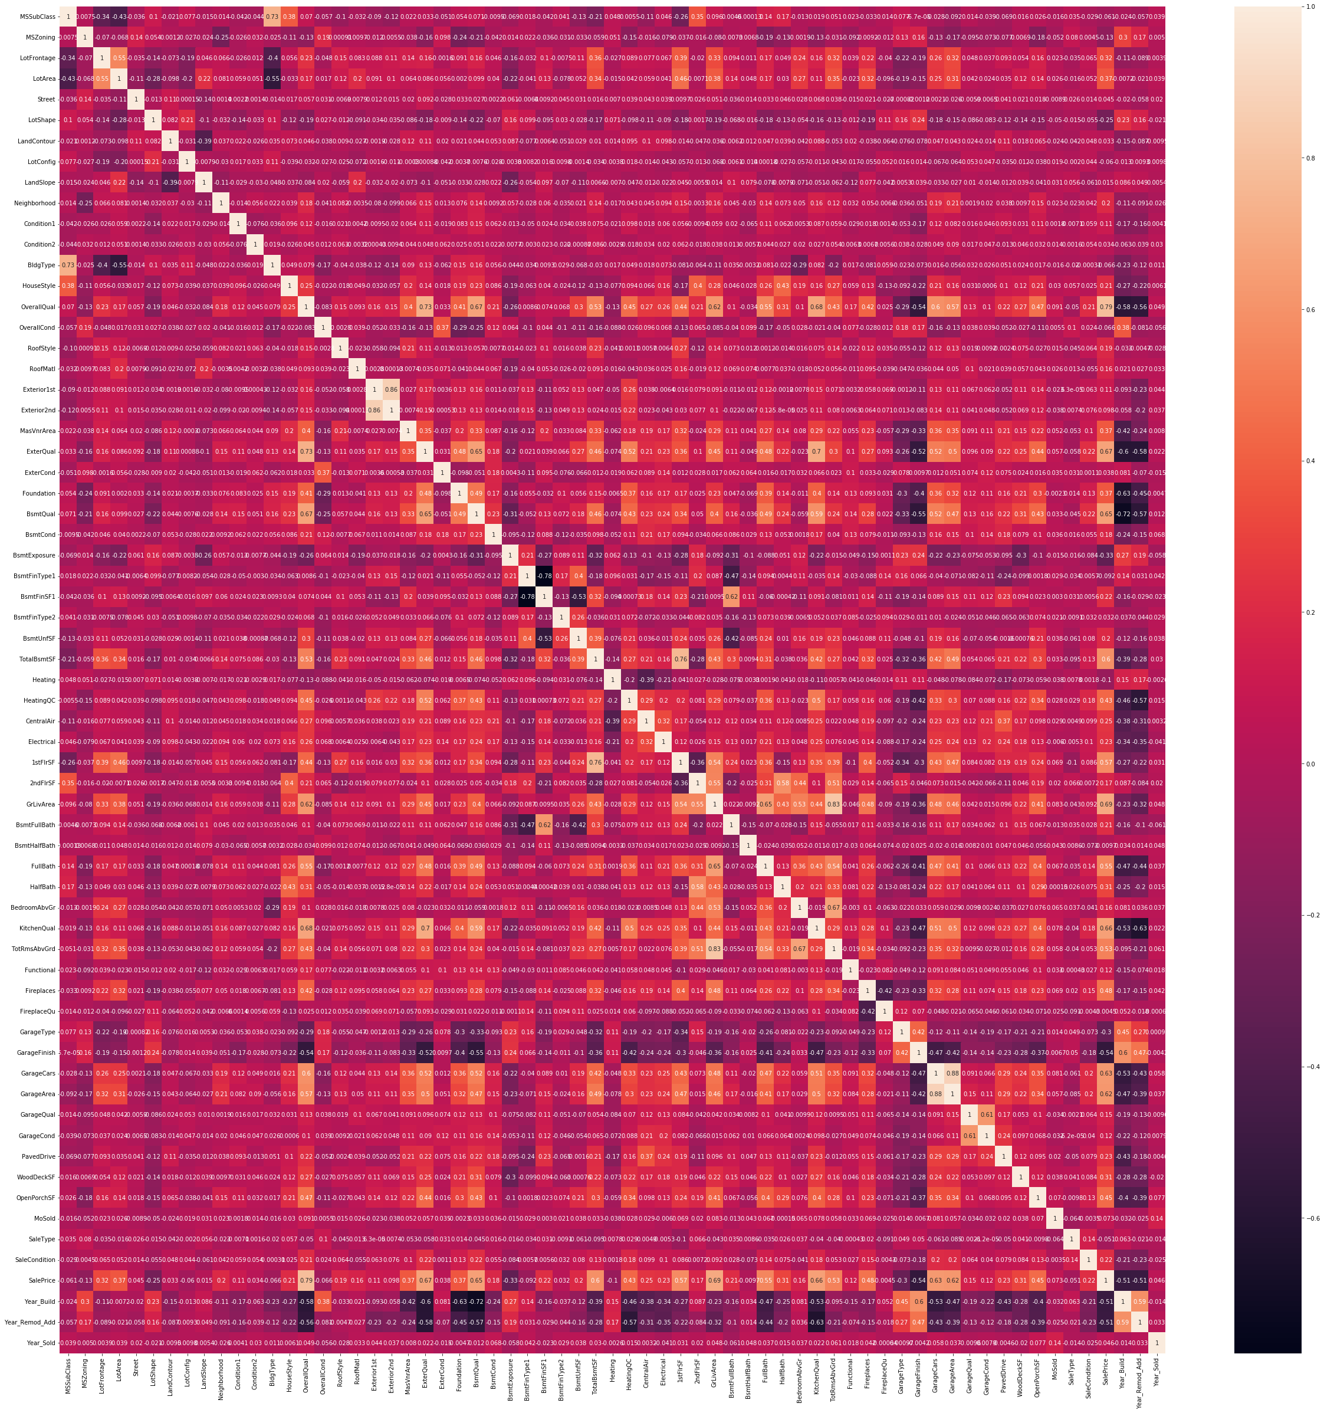
Correlation of Train Data

Slide 22
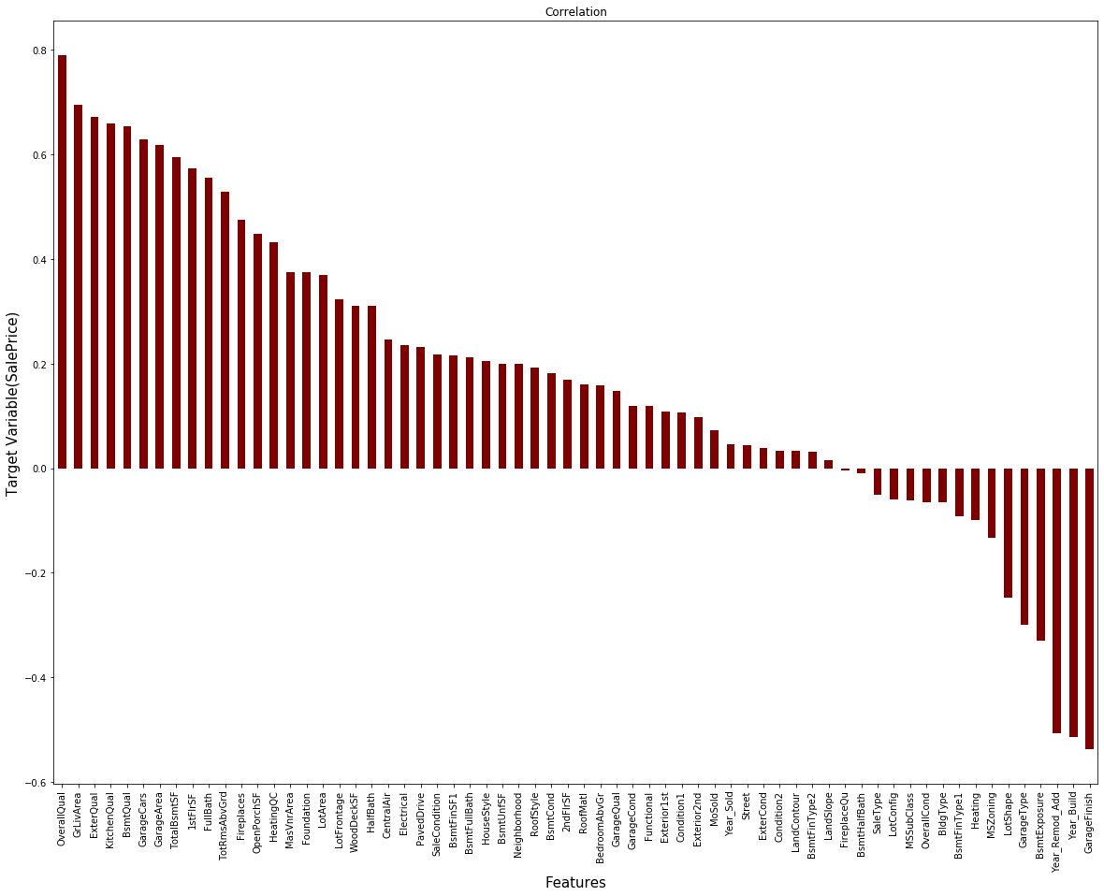
Correlation of Features and Target variables

Slide 23
Data cleaning
We use imputation technique to replace the null value.
To remove outliers we use the Zscore method.
To remove skewness we use preprocessing technique using Power Transformer ‘yeo-johnson’ method.
We converted the categorical data to numerical data using Label Encoder.
We use the correlation technique to check the correlation of each features.
We use Standard Scaler to scale the data.
Used various model and check the cross validation score to make the better prediction.

Slide 24
Model Building:
Our target variable is Sale Price and it is continuous columns. This is a regression problem. We have to use the regression model to make the prediction.
We have used various Regression model and checked the r2 score, mean squared error and mean absolute error.
We checked the cross validation score of various model.
These are some of the model used in House price prediction Project
Linear Regression
Random Forest Regressor
KNeighborsRegressor
Decision Tree Regressor
Gradient Boosting Regressor
Ada Boost Regressor
Support Vector Regressor
Bagging Regressor
SGBRegressor

Slide 25
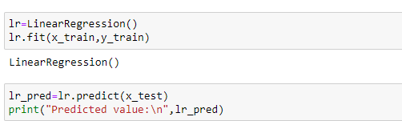
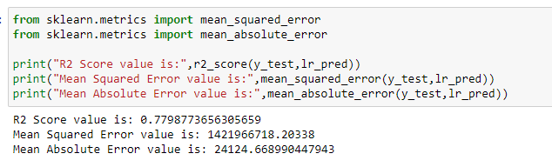
Linear Regression
Linear Regression Model gives 78% accuracy

Slide 26
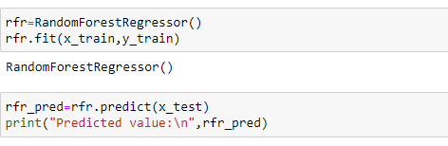
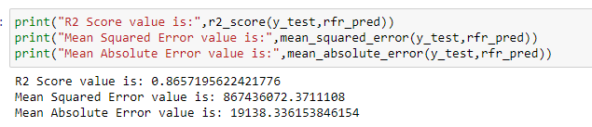
RANDOM FOREST REGRESSOR
Random Forest Regressor gives 86% accuracy

Slide 27
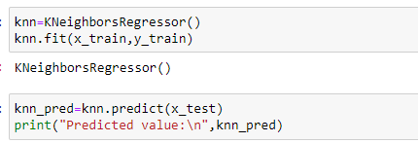
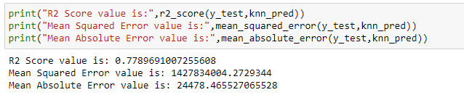
KNEIGHBORS REGRESSOR
Kneighbors Regressor gives 77% accuracy

Slide 28
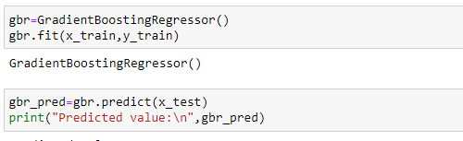
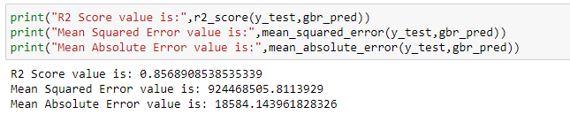
GRADIENT BOOSTING REGRESSOR
Gradient Boosting Regressor gives 86% accuracy

Slide 29
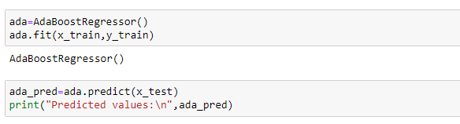
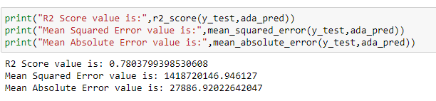
ADA BOOST REGRESSOR
Ada Boost Regressor gives 78% accuracy

Slide 30
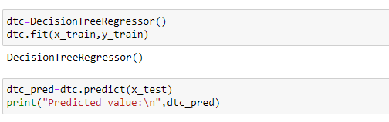
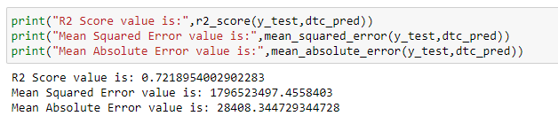
DECISION TREE REGRESSOR
Decision Tree Regressor gives 72% accuracy

Slide 31
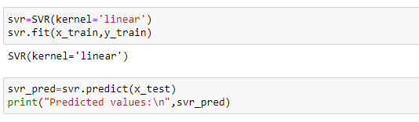
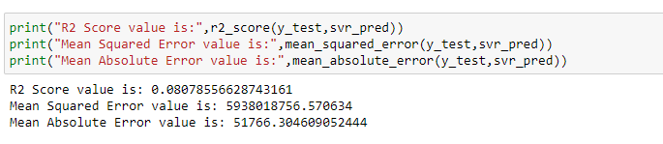
SUPPORT VECTOR REGRESSOR
Support Vector Regressor gives 80% accuracy

Slide 32
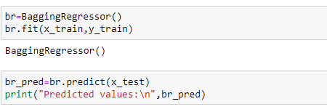
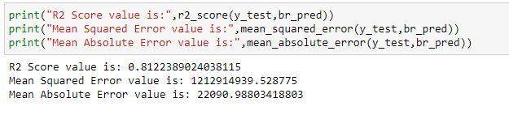
BAGGING REGRESSOR
Bagging Regressor gives 81% accuracy

Slide 33
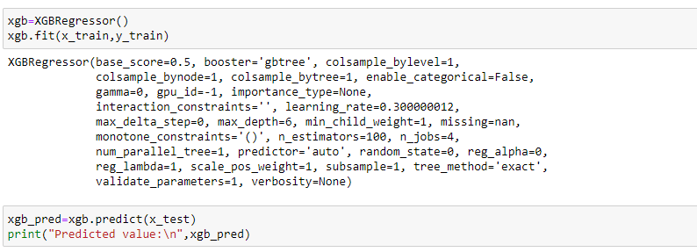
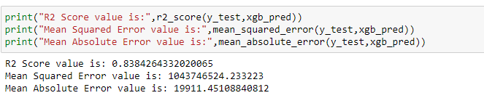
XGB REGRESSOR
XGB Regressor gives 83% accuracy

Slide 34
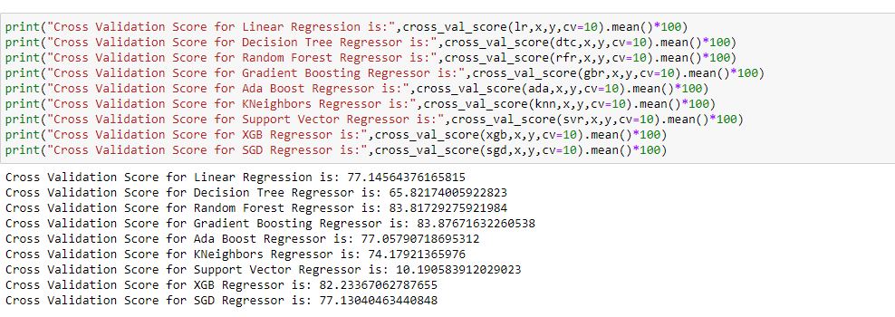
CROSS VALIDATION SCORE
This is the cross validation score for various model. We see that Random Forest Regressor gives a good cross validation score 84%.

Slide 35
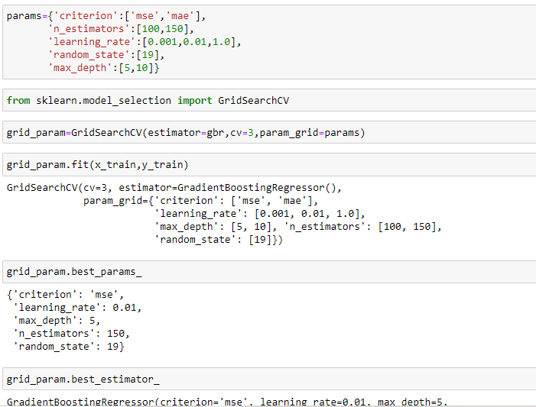
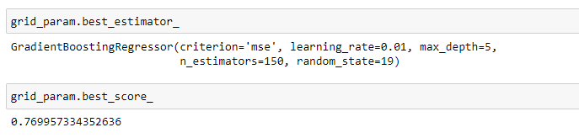
Hyper Parameter Tuning
In Tuning the parameter we got the best score as 77%

Slide 36
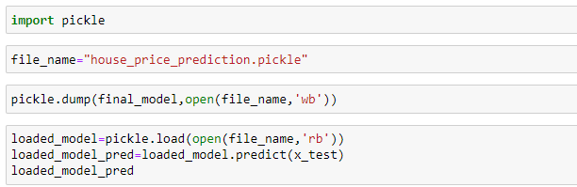
Saving the Model
We use the Pickle to save our model. Filename as house_price_prediction. We load the data in the read mode.

Slide 37
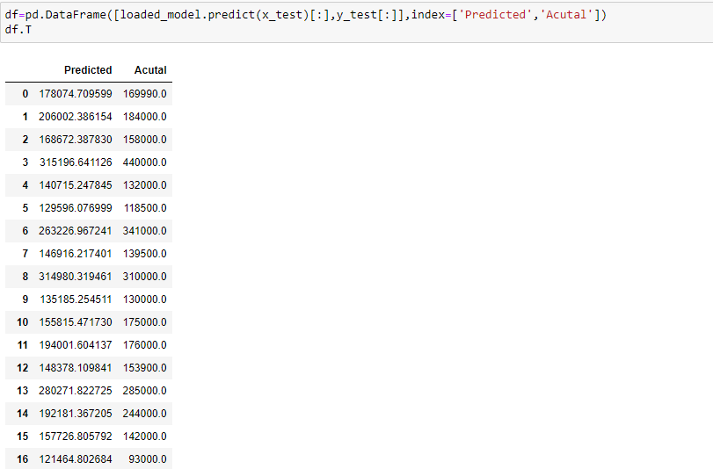
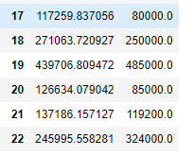
Predicted and Actual Value

Slide 38
Conclusion
In this project we have used various machine learning model and cross validation score to make the prediction.
We have checked the r2 score, mean squared error and mean absolute error of data.
We have done the feature engineering, exploratory data analysis and cleaning of data.
We analyse the each features and check the correlation of data. Removed the skewness and Outliers using the appropriate technique to give the good accuracy.
We use the hyper parameter tuning to increase the accuracy.
We use the variance inflation factor to remove the multi-collinearity.
Based on our prediction, it will provide a good insight to make the prediction of house price.

Slide 39
Thank you

